Slide 1
Install Collaboratory
Create a folder in your Google Drive for lab tasks.
Upload the python notebook file (.ipynb file) to the folder.

Slide 2
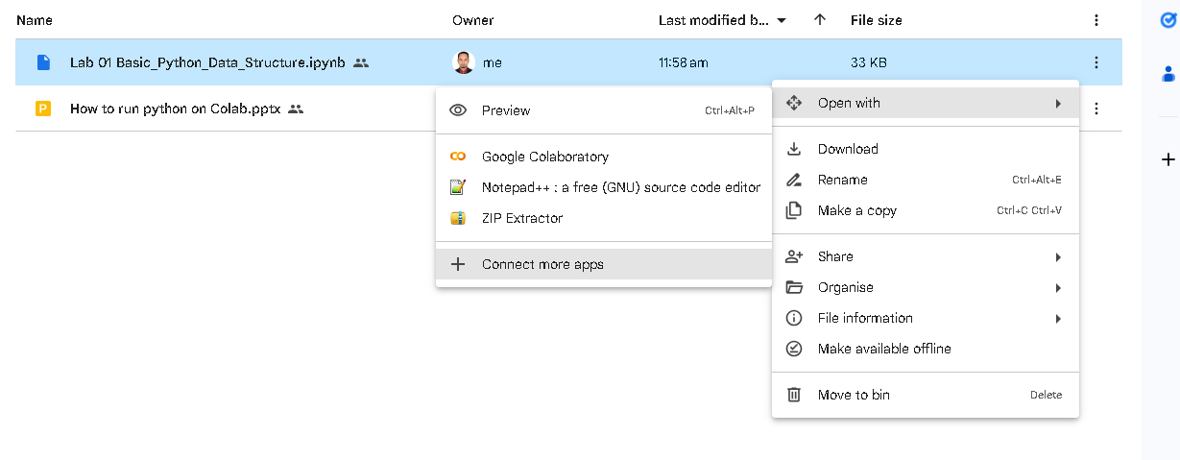
Install Collaboratory (if not installed before)
Open with -> connect more apps
Search Colaboratory and install

Slide 3
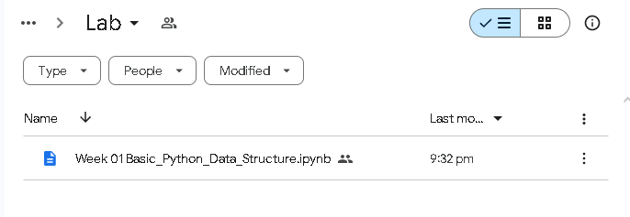
Double Click to open the file and complete code

Slide 4
Submission
From the file option you can download the .ipynb file and submit

